Slide 1
Workshop Goals
01
02
03
04
Portfolio Rationalization
Tool base Based Portfolio Analysis Framework to Modernize the Applications
Architecture Enhancements
Recommendations on the existing DX Architecture
AI Dev Sec Ops
Hexaware AI based Platform with standard approach and standard methodologies for Product Management& Planning , Development and Maintenance of the Applications
Automation & IPs
Hexaware custom built accelerators and IP platforms helps to accelerate the transformation of the Applications in to Digital Platform.
Rationalization Analysis
Tool Driven Inventory Analysis and Classification
Tool Driven Dependency Analysis
Recommendations
A
A
A
A
AMAZE_APPTRANS
Perform the Dependency Analysis of the Application Codebase and build micro services Automatically
Development Lifecycle
Scaled Agile Framework based Lifecycle Management
Automate Building of Micro services
Automatized Unit, Functional, Performance Management
B
B
Unit Test Generator
Accelerates the process of creating Unit Test Cases and Test Data for Existing Legacy Application codebase in minutes
B
Architecture Recommendations
Horizon Planning &Horizon Delivery
Based on the portfolio rationalization and dependency analysis reports , Applications divided into multiple horizons
B
Deployment and Management
Azure DevOps to deploy the services in to Open Shift
Hexaware Raise IT Platform managing the incidents

Slide 2
Portfolio Rationalization Framework
Horizon Planning
Application Selection
Impact Analysis
Effort Estimation
Skill Identification
Sprint Team Planning
Scope Finalization
Horizon Delivery
Develop
Remediate the dependencies
Test
Deliver
Portfolio Rationalization & Analysis
Tool Driven Inventory Analysis & Classification
Tool Driven Dependency Analysis

Slide 3
Our Recommended Enhancement For Future State Architecture
Current Architecture
Hexaware Recommended Enhancements
Event Driven Message Based Integration
Common Digital Architecture & Platform
Iterative Mainframe & Midframe Decoupling
Container Based Microservices
Low Code – BPM EIP RPA
Microservices
Refactor technical code from the business services in to ServiceMesh Side Car
Observability
Distributed transaction monitoring
Distributed context propagation
Distributed tracing across microservices
Resiliency
Crash resilient microservices
Ai driven Auto roll back on production version failures
Microservice resiliency testing
Security
Manage authentication, Authorization and identity policies as sidecar
Key Vaults for secrets storage
Metrics &
Visualization
Latency, Traffic, Errors and Saturation metrics collection for microservices
Metrics dashboard
AI driven insights

Slide 4
Our Approach To Amend The Recommendations
Form Architecture Group
Discovery
Assessment
Implement
Automate
Continuous Improvements
Discovery
Focussed user group sessions
Understand the key architecture principles
Understand end state vision
Assessment
Architecture study
Identify areas of enhancements
Define recommendations
Implementation
Apply recommendations
Observe the performance
Apply findings
Continuous Improvement
Automate
Architecture Group
Cross functional swot team
  Enterprise Architect
  Cloud Native Architect
  Resiliency and Test Architect
  Automation Architect

Slide 5
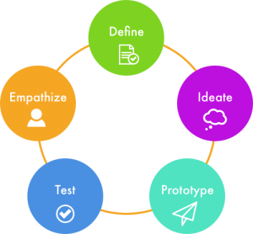


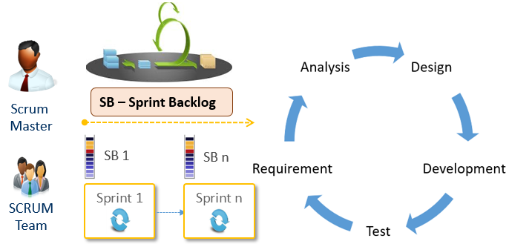

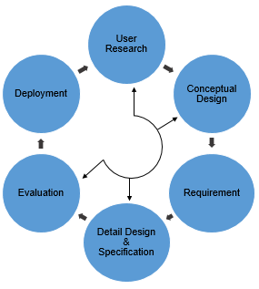
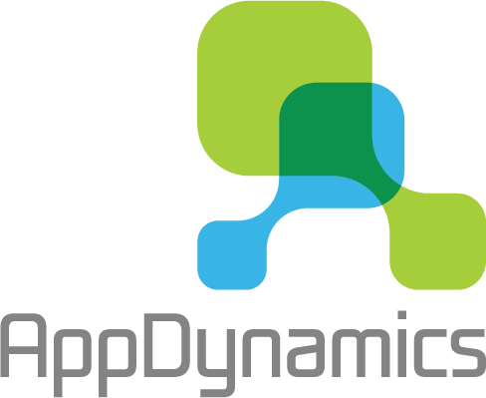


Development Approach
Product Management
& Planning
Development
Maintenance
Design Thinking
Hexaware AIOPS Platform
Development Life Cycle
Deployment
App Management
Blue
Hex
Raise IT
ITSM & Incident Management
L3 / L4
Usability Engineering
Service Mesh
L1 / L2 (Global)
Product
Backlog
App
Trans
Unit Test Generator
Iterative Cycle
REPOS Pipeline
User Insight
Green
Monitoring & Performance Management
Azure Cloud
Design Thinking:
Realize the identified product backlog feature
UX Design/prototypes of the feature would be developed
Usability Engineering:
Use Centric, Research based User Experience Redefinition
Development Life Cycle:
Automated Development of Micro services using Hexaware IP, Amaze for AppTrans
Automated test case generation for existing source code.
Converting existing manual test cases to automated scripts..
Scaled Agile based Life Cycle Management.
Automated Unit, Functional, Security, Performance Testing
CI/CD and CT Pipelines using Azure DevOps
AI Powered Operations and Management
Traffic Management, observability, Security and Policy Management using Service Mesh
Metrics Dashboard
Log Aggregation & Analytics
Auto Remediation of Tickets
Route Cause Detection &User Data Analysis
Insights And Actions & Metrics Dashboard

Slide 6
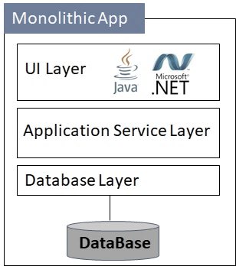
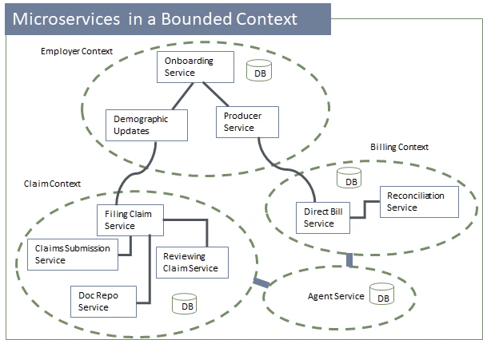
AMAZE for APP TRANSFORMATION – Monolithic to MicroServices Conversion
Monolithic application to Microservices/Azure functions.
Monolithic Database to service specific databases as JSON Db or RDBMS Db.
Self Service to extract the Microservices to run independently in a Bounded Context of Domain-Driven Design.
Dependency Analysis
Refactoring
Deployment
Rapid based analyse tool to detect the dependencies in the applications.
Interactive graphical representation of dependencies in Application-to-Application layer, Application-to-Transactional layer, Method layer.
Strangler / Mass transformation to Microservices or Azure functions.
Support Java and Dot Net Version.
Services are pushed to GitHub automatically.
Deployment of each service as a container in a bounded context.
App Trans
Dependency Analysis
Refactoring
Deployment

Slide 7
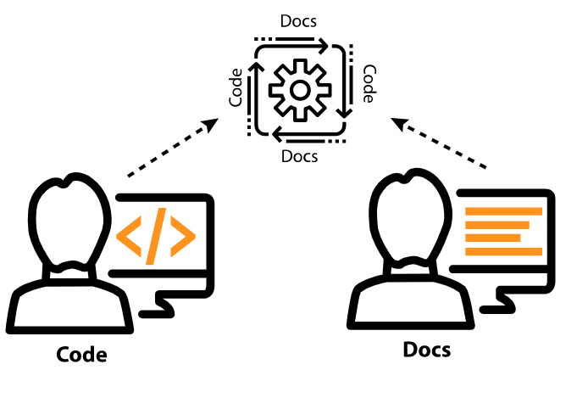

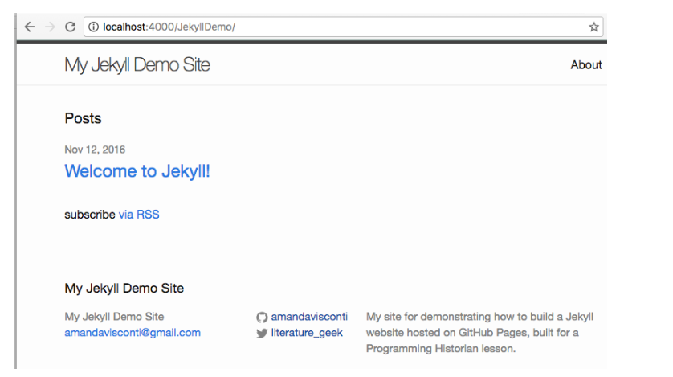
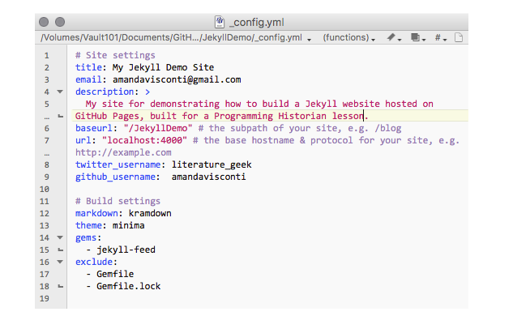
Document as Code
Documentation as Code is an approach of automating the documentation process while writing the code.
Automated Documentation can be exported and shared using external tools like GitHub Pages.
Approach
Below are the steps by which the Documentation as a code can be approached
Use open source static site generator
Store documents in Version control repository
Automate the process with CICD
Build package & Run Validation checks
Publish to GitHub Pages
Benefits
Documentation can be automatically synced with reference to changes in the source code.(Continuous delivery)
Increased collaboration with other contributors
Automatic Version Control
While Developing new features of VB, HB, SBB Product lines into new Digital Architectures, the developer will also create the code for document related to all the
business process and capabilities.
Look and feel of the documentation can be customized
Provides Clarity and up-to-date information about the application or software to the end user.
Fork Project
After compilation by GITHUB
GitHub Pages
Write Post using DOC as Code
Source Code Repo
Commit
Example
Sample Jekyll config.yaml file

Slide 8




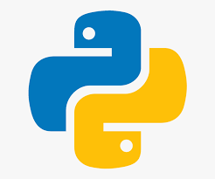

Automated Unit Test Case Generation
X-Unit Gen is an Hexaware’s IP tools developed using Python Framework which helps to accelerate the process of creating unit test cases and test data automatically for an existing legacy dotnet application within minutes.
CHALLENGES
WHAT X-UNIT DOES?
BENEFITS
Manual creation of unit test cases for an existing application that has millions of lines of code will be challenging and takes a longer time.
Limitation in the number of scenarios and test data that the developer can use to verify the source code
Expensive and Time Consuming
Python code reads through the entire source code directory and creates the test cases automatically in a mins.
Generates the Test data provided by user in an Excel sheet or by using its internal test data generator.
100% Unit Test Coverage
Automated Test case & Test Data Generation
Cost & Time saving
Doesn’t Require highly skilled Developers
Code Coverage
Application
X-UNIT
Generator
Code Coverage
Validation
Test Cases

